Slide 1
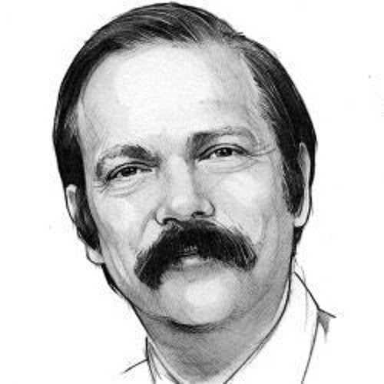

The Joy of Automata
Rajeev Alur
University of Pennsylvania
VardiFest, July 2022

Slide 2
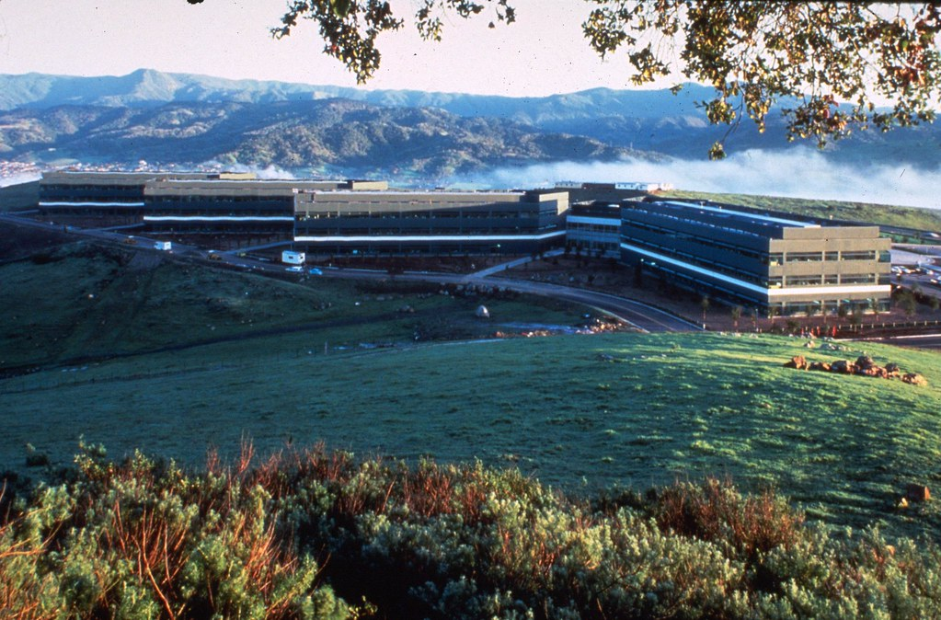
Gratitude for Decades of Mentorship …
My first “job”
Intern, Summer 1990
Department of Mathematics
and Related Computer Science
IBM Almaden Research Center, San Jose, CA
Manager: Moshe Vardi

Slide 3

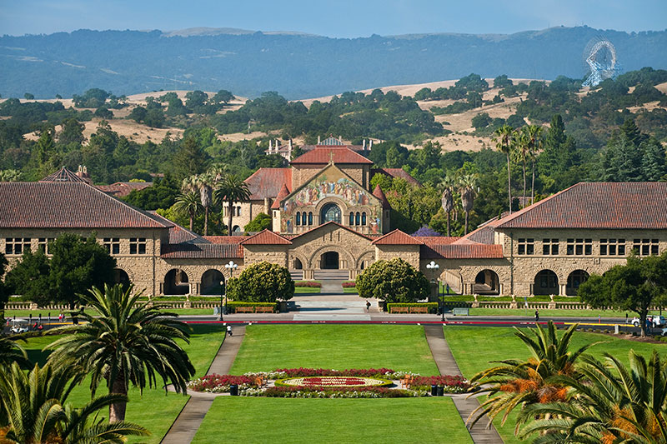
PhD Thesis Committee
Techniques for automatic verification of real-time systems
(Timed automata)
Stanford University, August 1991

Slide 4
Collaborations
Parametric real-time reasoning
Alur, Henzinger, and Vardi; STOC 1993
Alternating refinement relations
Alur, Henzinger, Kupferman, and Vardi; CONCUR 1998
(CONCUR Test-of-Time Award)
Theory in practice for system design and verification
Alur, Henzinger, and Vardi; ACM SIGLOG News 2015

Slide 5
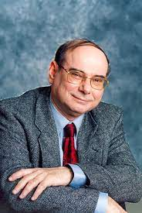
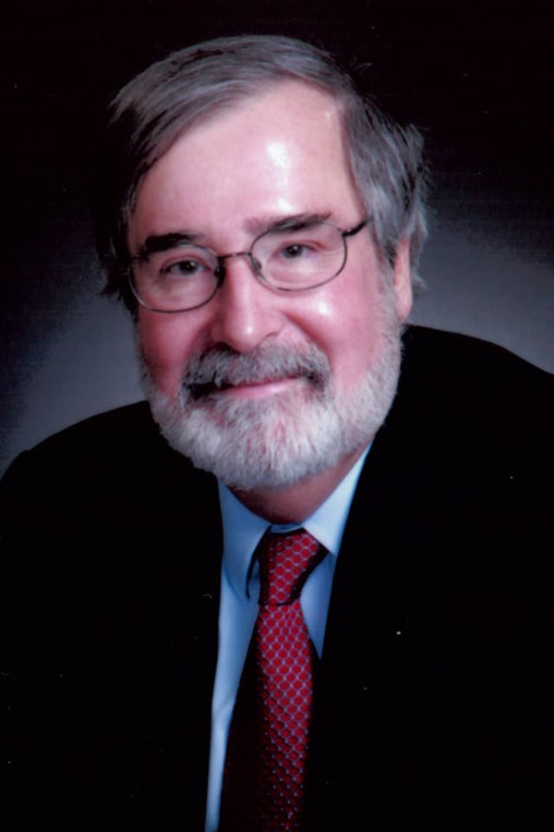
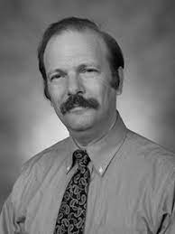
Three Pillars of CAV from Three Decades Ago
Methodology: how to specify and verify properties ?
Temporal logic
Tools: how to scale to systems of practical interest?
(Symbolic) Model checking
Foundations: how to make CAV research “intriguing”?
Automata over infinite words/trees

Slide 6
Why Automata ?
Specification Logics
Monadic Second-Order Logic (MSO)
Temporal logic
Mu-calculus
Linear vs branching models
Decision problems
Membership
Satisfiability / Emptiness
Equivalence / Implication
Synthesis
Automata
Deterministic / Nondeterministic / Alternating
For finite/infinite words/trees
Automata constructions
Determinization

Slide 7
Automata over Infinite Words: The Intrigue …
q,r
p,r
Model: Infinite sequence over {p, q, r}
Property: Every p is followed by q
G ( p ➔ F q )Property:
p
q
Deterministic Buchi automaton
q
q
G F p ➔ G F q
If p repeats, so should q
q,r
Nondeterministic Buchi automaton
Provably, no deterministic Buchi automaton exists!

Slide 8
Determinization of Automata over Infinite Words
p
q
G F p ➔ G F q
q
1
p
2
p
r
r
q
0
r
Deterministic Parity automaton
Highest repeating color should be even
Technical challenge: Optimal translation from nondeterministic Buchi automata to deterministic parity automata

Slide 9
Time for Logics and Automata
Executions of real-time systems modeled as timed words
Sequence of events with non-decreasing real-valued time-stamps
q
p
Bounded response: G ( p ➔ F_{< 1} q )
Every p is followed by q within 1 unit
p, x:=0
x<1 & q
(Deterministic) Timed automaton
x=0
x=1
0
p
p
1
2
Technical challenge: State-space is infinite due to real-valued clock variables but emptiness is decidable due to a finite-quotienting construction

Slide 10
The Curse of Punctuality
x=0
x=1
0
p
p
1
2
Exact Bounded response: G ( p ➔ F₌₁ q )
Not specifiable using timed automata!
Intuitively need unboundedly many clock variables
Property: Exist two events p and q exactly 1 time apart
Specifiable using a nondeterministic timed automaton (but not deterministic)
Nondeterministic not closed under complement, and not determinizable
Equivalence of nondeterministic TA is undecidable

Slide 11
More Intrigue …
t
t’
t+1
t’+1
t+2
t’+2
0
p
p
1
2
3
MITL: Temporal operators with non-singular intervals:
G ( p ➔ F_{(1,2)} q )
Challenge: Time for every p in interval [0,1] is potentially relevant
No obvious translation to timed automata
But undecidability proofs crucially use singular intervals

Slide 12
MITL Satisfiability
MITL property: G ( p ➔ F_{(1,2)} q )
t-1
t’-2
t
t’
0
1
Last q
2
First q
3
MITL can be effectively translated to nondeterministic TA
Satisfiability is decidable (Expspace-complete)
Alternative approach: Two-way deterministic timed automata

Slide 13
The Joy of Automata: A Personal Journey
Real-time temporal logics (1989-94)
Timed automata, 1990
Hybrid automata, 1993
Alternating-time temporal logic, 1997
Nested word automata and visibly pushdown languages, 2004
Streaming string transducers, 2011
Streaming tree transducers, 2012
Quantitative regular expressions, 2016
Automata over series-parallel graphs
Ongoing work, joint with Caleb Stanford and Chris Watson

Slide 14
Talk Outline
What are (Synchronized) Series-Parallel Graphs ?
What’s the motivation for this model ?
Automata over SSPGs
A robust theory of regular languages of SSPGs: review of results
What’s intriguing, theoretically ?

Slide 15
(Synchronized) Series Parallel Graphs
Base case
Sequential composition
Ordered (ranked)
parallel composition
Unordered (unranked)
parallel composition

Slide 16
SSPG Features
A class of directed acyclic graphs
Each SSPG has a unique source and unique sink
Edges have types (colors) which capture shape
  Sequential
  Left-split / Right-split; Left-join / Right-join
  Unordered-split; Unordered-join
  Synchronization
Unique path from source to sink by sequential and synchronized edges
Vertices labeled with elements of finite alphabet

Slide 17
Modeling Data in Stream Processing Systems
Input stream
Output stream
A starting point:
A stream is a linear sequence of items of a data type
If input/output data types are A/B, then an operator is a monotonic function from A* to B*
Requiring all items to be strictly ordered is restrictive
Relational query optimization not applicable:
How to parallelize correctly ?
Distributed systems have events that aren’t causally related:
Is overhead to force consistent ordering needed ?

Slide 18
Partially-ordered Semantics for Streams
Input stream
Output stream
Beyond linear sequences:
Relation that gets incrementally updated ?
Sequence of relations (see CQL [Arasu et al, 2006] )
Sequences with punctuation markers (see [Maier et al, 2010])
What about streams partitioned on key values ?
Unifying framework: View streams as labeled series-parallel graphs and operators as monotonic transformers over these
Reference: Synchronization Schemas (Keynote, PODS 2021)

Slide 19
Illustrative Streaming Computation
Different colors:
different taxis
GPS/BeginRide/EndRide events
Ordering / synchronization constraints (a logical view):
Events of the same taxi are linearly ordered
All events are ordered w.r.t. EndOfDay synchronization events

Slide 20
Stream as a Series-Parallel Graph
: EndOfDay synchronization events
: GPS/BeginRide/EndRide events
Different colors: different taxis
Ordering constraints as a contract:
For ordered items, implementation should enforce strict temporal order
For unordered items, result of computation should not depend on exact order in which they get processed (or in parallel)

Slide 21
SSPGs and Distributed Stream Procesing
Modeling data streams as series-parallel graphs
  Shape expressed by “synchronization schemas”
  Unordered parallel composition corresponds to key-based partitioning
  Facilitates correct parallel processing
  Unified foundation for semantics of many operators in stream processing
Automata over SSPGs can capture “integrity constraints” over data:
“for each taxi, each day, BeginRide and EndRide events alternate”
though they cannot capture relational queries and aggregates

Slide 22
How to define Automata over SSPGs?
Standrd: Finite set of states Q, initial state q₀, accepting states F
What about transition function ?
Literature guide: Automata over trees, graphs, nested words
Desired goal: a robust theory of regular languages
Equivalent to MSO logic over such graphs (this definition is fixed!)
Closed under Boolean operations, homomorphism/projection
Determinization (note: not possible for (series-parallel) graph automata)
Decidable emptiness and equivalence

Slide 23
Defining Transition Function
Sequential, Ordered split, and unordered split edges: single predecessor
δ_{seq} : Q x Σ → Q
δ_{ordered-split} : Q x Σ → Q x Q
δ_{unordered-split} : Q x Σ → Q
Note: at an unordered split vertex, A sends the same state to all children
In nondeterministic version, RHS is a set of states (or pairs of states)
At unordered split, different children may get different states

Slide 24
Transition Function for Ordered Join
State determined by states at the three predecessors
δ_{ordered-join} : Q x Q x Q x Σ → Q

Slide 25
Transition Function for Unordered Join
State determined by state at synchronization predecessor and multiset of states at join predecessors
What are “regular” (MSO-definable) properties of a multiset?
Boolean combination of predicates such as “count of an item </=/> const”
Unordered-join transition function: Q x [Q → [0..k]] x Σ → Q
k : counting complexity of automaton
A multiset S over Q is mapped to f_{S} : Q → [0..k]
f_{S}(q) = n < k if S contains n copies of q
= k if S contains >=k copies of q

Slide 26
Examples of Regular Properties
: labeled with EOD
: labeled with B, E, G
Each parallel subgraph between successive EOD, matches (B G* E)*
Last B may not have matching E in subgraph, but at most 3 such subgraphs
At least 5 parallel subgraphs
Not regular: number of subgraphs between successive stages is same

Slide 27
Summary of Results: Expressiveness
A language of SSPGs is regular if accepted by deterministic automata
Thm: Regular languages are closed under union, intersection, complement, homomorphism, reverse, …
Thm: A nondeterministic automaton with n states and count k can be translated to deterministic one with 2^{n²} states and count n.k
Thm: Expressiveness of deterministic automata increases with count, but for nondeterministic, count of 2 suffices
Thm: Regular languages can be equivalently characterized by MSO as well as graded μ-calculus

Slide 28
Summary of Results: Decision Problems
Membership: Does an automaton A accept a given SSPG G ?
  Linear-time for deterministic A
  PTime for nondeterministic A
Emptiness: Given an automaton A, does it accept some SSPG ?
  PTime for nondeterministic A
Inclusion: Does an automaton B accept every SSPG accepted by A ?
  PTime for deterministic B
  ExpTime-complete for nondeterministic B

Slide 29
The Role of Synchronization Edges
Allows information to be passed directly from split vertex to matching join
Inspired by call-return edges in nested words / visibly pushdown automata
Crucial in determinization and MSO equivalence
Example property:
There is exactly one a-labeled vertex

Slide 30
Counting Complexity
Property L_{s}: Graph contains s vertices combined by unordered parallel
Deterministic case:
Each parallel vertex returns same information
At join must know whether the count is s or strictly less/greater than s
Count must be s+1
Nondeterministic case:
Nondeterministically send a state from {q₁, … q_{s}}
At join, require exactly one count of each q_{j} (2 leads to rejection)
Count of 2 suffices
Regular properties are not bisimulation invariant
Counting complexity of 1 ⬅➔ Bisimulation invariant properties !

Slide 31
Graded μ-calculus
Variant of classical μ-calculus interpreted over labeled transition systems
Propositions for state-labels
Set variables and least/greatest fixpoint operators
Boolean connectives
Graded existential modality: <n,a>ϕ means n a-successors satisfy ϕ
Graded universal modality: [n,a]ϕ means at most n a-successors satisfy ϕ
History
Introduced by Janin and Lenzi [LICS’01]
Complexity over infinite trees: Kupferman, Sattler, and Vardi [CADE’02]
Expressive Equivalence
Graded μ-calculus can be translated to MSO [JL’01]
Graded μ-calculus can encode regular SSPG languages
Proof encodes accepting automaton runs over Reversed graphs

Slide 32
In Conclusion …
Thanks to Moshe for his mentorship,
and for introducing me to the joy of automata and logics
which still has unexplored challenges

